Slide 1
E-Project
Alpine Ascent
(Mountaineering)

Slide 2
Introduction
Faculty Name:- Miss Nashmia Khan
Cordinator Name:- Miss Madiha Fatima
Batch Code:- 2305G1
Students Name:- Zainab Waseem, Ramsha Hanif, Wadain Imran, Ambreen Shamshair.

Slide 3
Detail About E-Project
Mountaineering also called mountain climbing, the sport of attaining or attempting to a attain high points in mountainous regious mainly for the pleasure of the climbs although the term is often loosely applied to walking up low mountains that offer only moderate difficulties it is more properly restricted to climbing in localities where the terrain and weather conditions present such hazards that for safety a curtain amount of previous experience will be found necessary for the untrained mountaineering is dangerous pastime .

Slide 4
Site-Map Of Our Website
Home
More Info
Techniques
Sheltering
History
Contact Us
About Us
Images Gallery

Slide 5
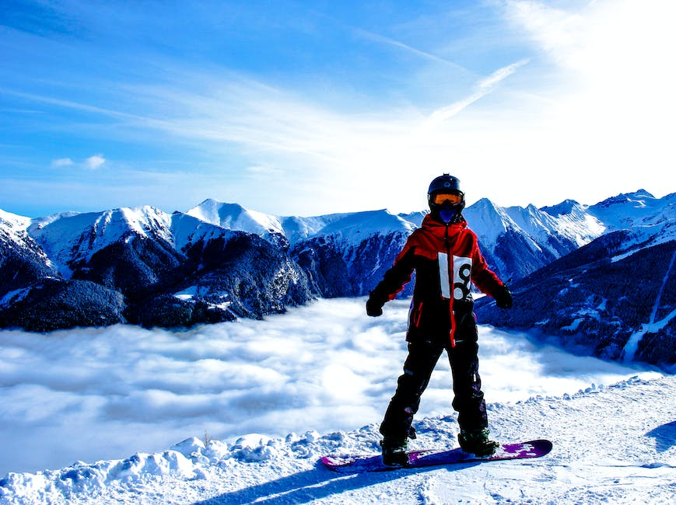

Future Enhancement
We could consider adding interactive features like a virtual tour of famous mountains or a section with tips and resources for beginners. Additionally, we could incorporate a live weather update for mountain regions.

Slide 6
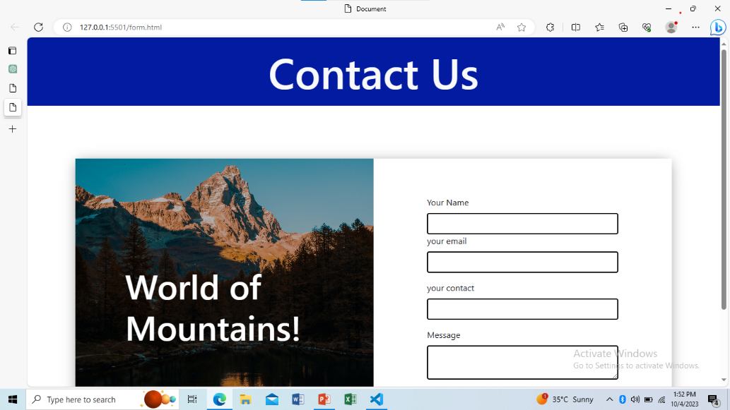
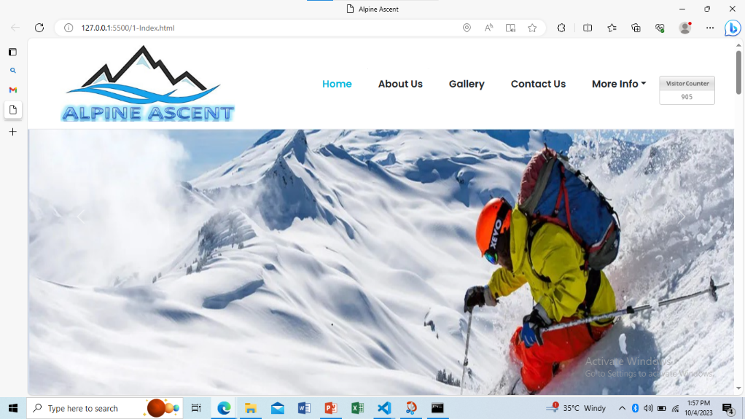
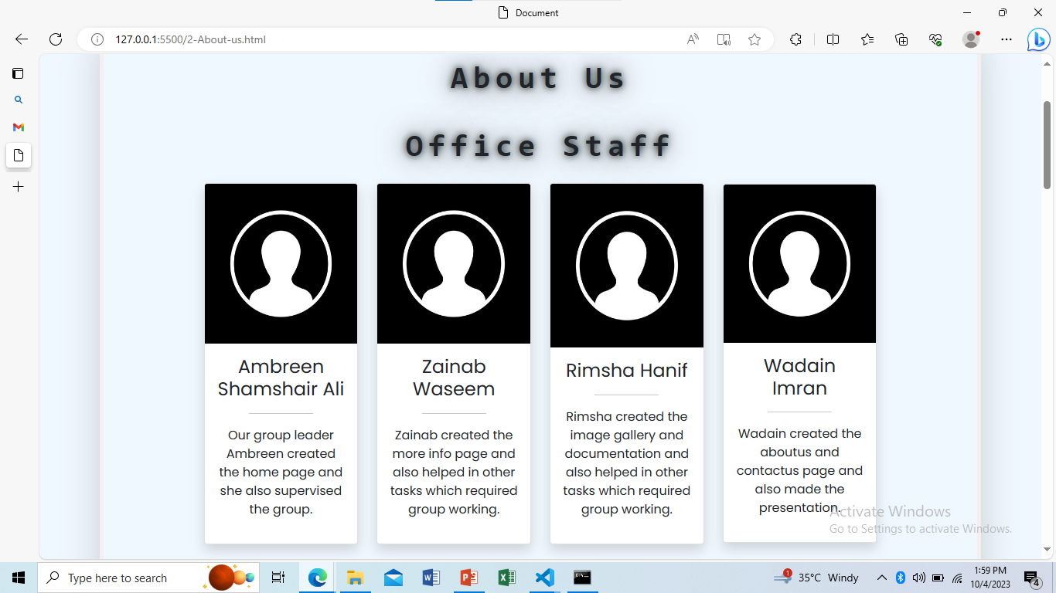
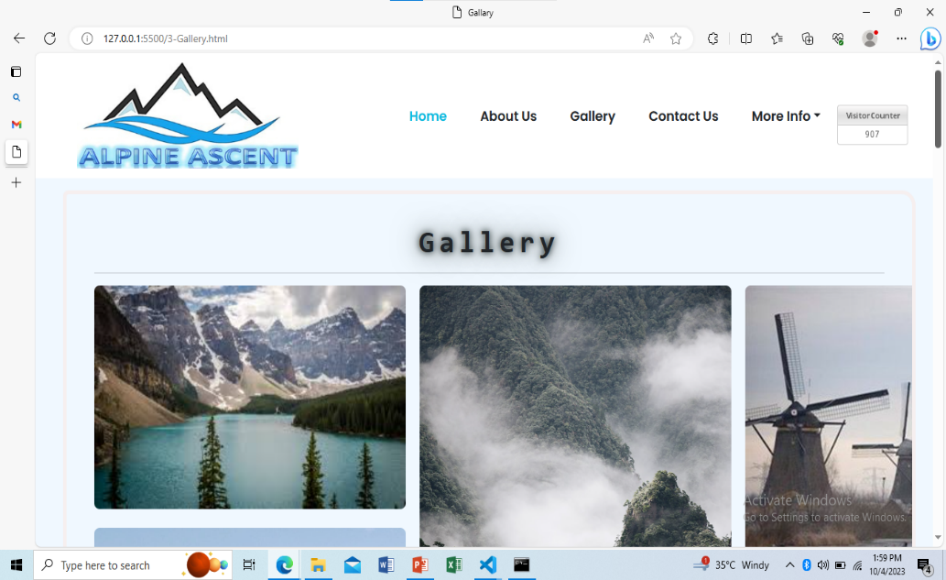
Admin Can Perform These Tasks:

